Slide 1
Simplicial machine learning

Slide 2
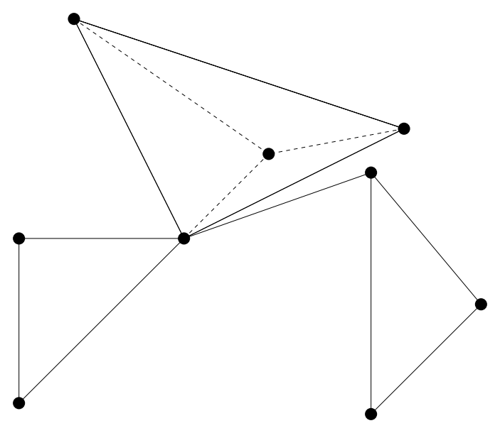
Graphs are limited to pair-wise interactions
Cliques occur naturally in a social networks.
Co-authorship network
Notes:
Simplicial complexes are structures that capture relations between a set of entities. In this figure, we present a co-authorship network. If a pair of scholars have worked together, there will be an edge between them. Graphs are limited in expressivity, because we can only represent binary information between nodes.

Slide 3
Graphs are limited to pair-wise interactions
Cliques occur naturally in a social networks.
Can we distinguish if the three authors have three papers or one paper?
Co-authorship network
Notes:
For example, we do not know if the highlighted authors have collaborated on a paper or if the three pairs have three different papers.

Slide 4
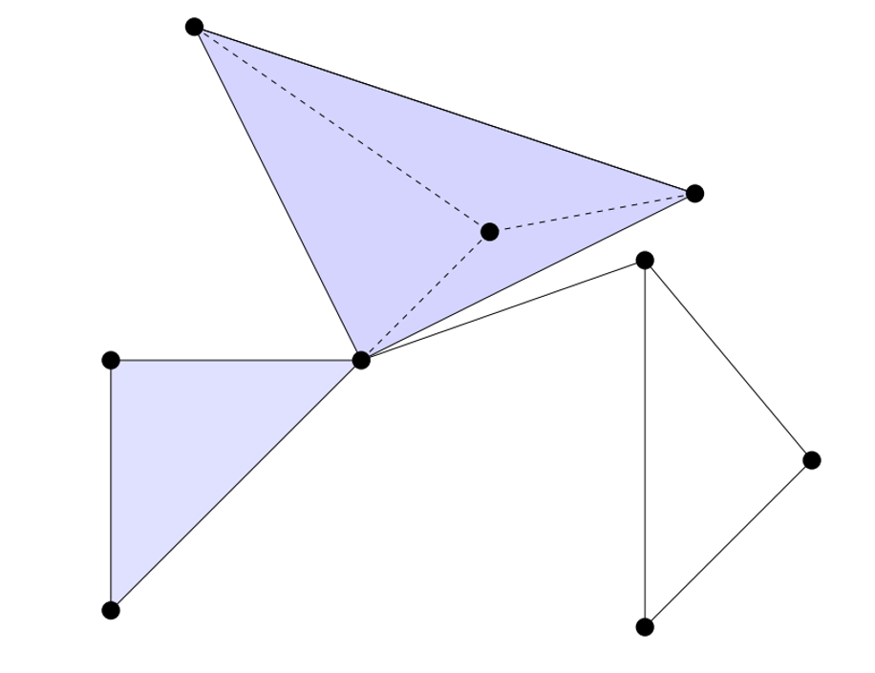
Graphs are limited to pair-wise interactions
Cliques occur naturally in a social networks.
Can we distinguish if the three authors have three papers or one paper?
We can model these cliques as a simplex.
A set of simplices is called a simplicial complex.
Co-authorship network
Notes:
However, we can now interpret using a filled triangle that they have worked together. Such triangles are called 2-simplex.
Simplicial neural networks are SC based message-passing networks, which are more expressive than graph neural networks because they process high-order information. However, training SNNs requires task-specific labels, which can be expensive and difficult to retrieve when dealing with multiple labeling schemes and sensitive information.

Slide 5
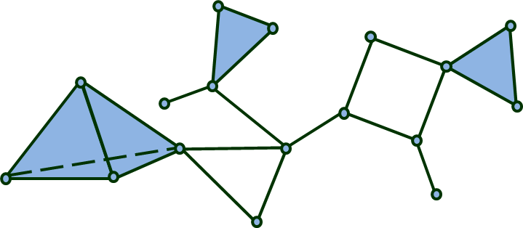
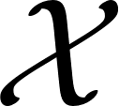


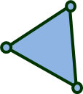
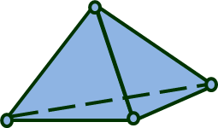
Simplicial Complex
A simplicial complex (SC) is a generalization of graphs which allows higher-order relations.
A simplicial complex is a subset of the powerset the vertex set .
A simplicial complex is closed under subset, i.e. .
A simplicial complex
$0$-simplex $1$-simplex $2$-simplex $3$-simplex
A $k$-simplex is an ordered subset of $k+1$ nodes
Notes:
However, we can now interpret using a filled triangle that they have worked together. Such triangles are called 2-simplex.
Simplicial neural networks are SC based message-passing networks, which are more expressive than graph neural networks because they process high-order information. However, training SNNs requires task-specific labels, which can be expensive and difficult to retrieve when dealing with multiple labeling schemes and sensitive information.

Slide 6
Simplicial complex
Notes:
However, we can now interpret using a filled triangle that they have worked together. Such triangles are called 2-simplex.
Simplicial neural networks are SC based message-passing networks, which are more expressive than graph neural networks because they process high-order information. However, training SNNs requires task-specific labels, which can be expensive and difficult to retrieve when dealing with multiple labeling schemes and sensitive information.

Slide 7
Simplicial complex
Notes:
However, we can now interpret using a filled triangle that they have worked together. Such triangles are called 2-simplex.
Simplicial neural networks are SC based message-passing networks, which are more expressive than graph neural networks because they process high-order information. However, training SNNs requires task-specific labels, which can be expensive and difficult to retrieve when dealing with multiple labeling schemes and sensitive information.

Slide 8
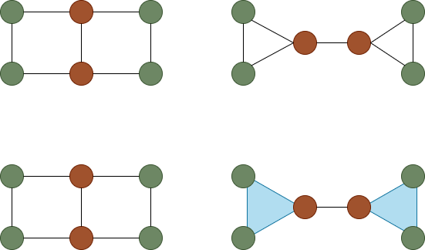
WL test
WL is also limited in its capability of distinguishing cliques.
These two graphs cannot be distinguished by 1-WL.
But they have different clique complex.
Notes:
However, we can now interpret using a filled triangle that they have worked together. Such triangles are called 2-simplex.
Simplicial neural networks are SC based message-passing networks, which are more expressive than graph neural networks because they process high-order information. However, training SNNs requires task-specific labels, which can be expensive and difficult to retrieve when dealing with multiple labeling schemes and sensitive information.

Slide 9
SWL test
Notes:
However, we can now interpret using a filled triangle that they have worked together. Such triangles are called 2-simplex.
Simplicial neural networks are SC based message-passing networks, which are more expressive than graph neural networks because they process high-order information. However, training SNNs requires task-specific labels, which can be expensive and difficult to retrieve when dealing with multiple labeling schemes and sensitive information.

Slide 10
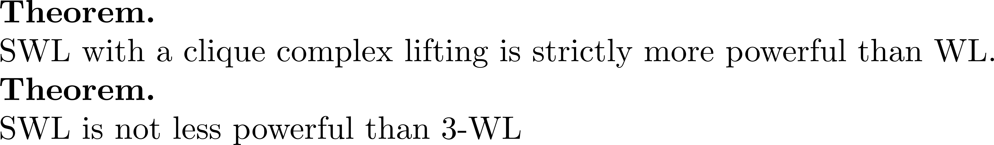
SWL test
Notes:
However, we can now interpret using a filled triangle that they have worked together. Such triangles are called 2-simplex.
Simplicial neural networks are SC based message-passing networks, which are more expressive than graph neural networks because they process high-order information. However, training SNNs requires task-specific labels, which can be expensive and difficult to retrieve when dealing with multiple labeling schemes and sensitive information.

Slide 11
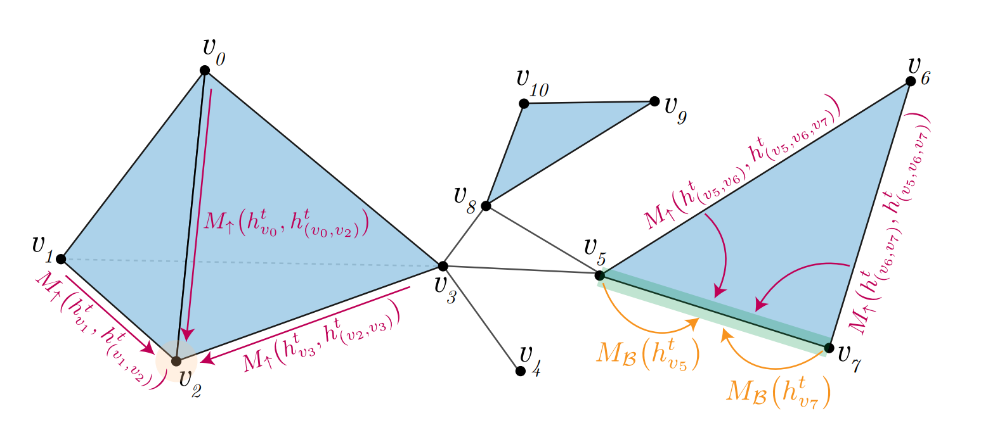
Message passing simplicial networks (MPSN)
Notes:
However, we can now interpret using a filled triangle that they have worked together. Such triangles are called 2-simplex.
Simplicial neural networks are SC based message-passing networks, which are more expressive than graph neural networks because they process high-order information. However, training SNNs requires task-specific labels, which can be expensive and difficult to retrieve when dealing with multiple labeling schemes and sensitive information.

Slide 12
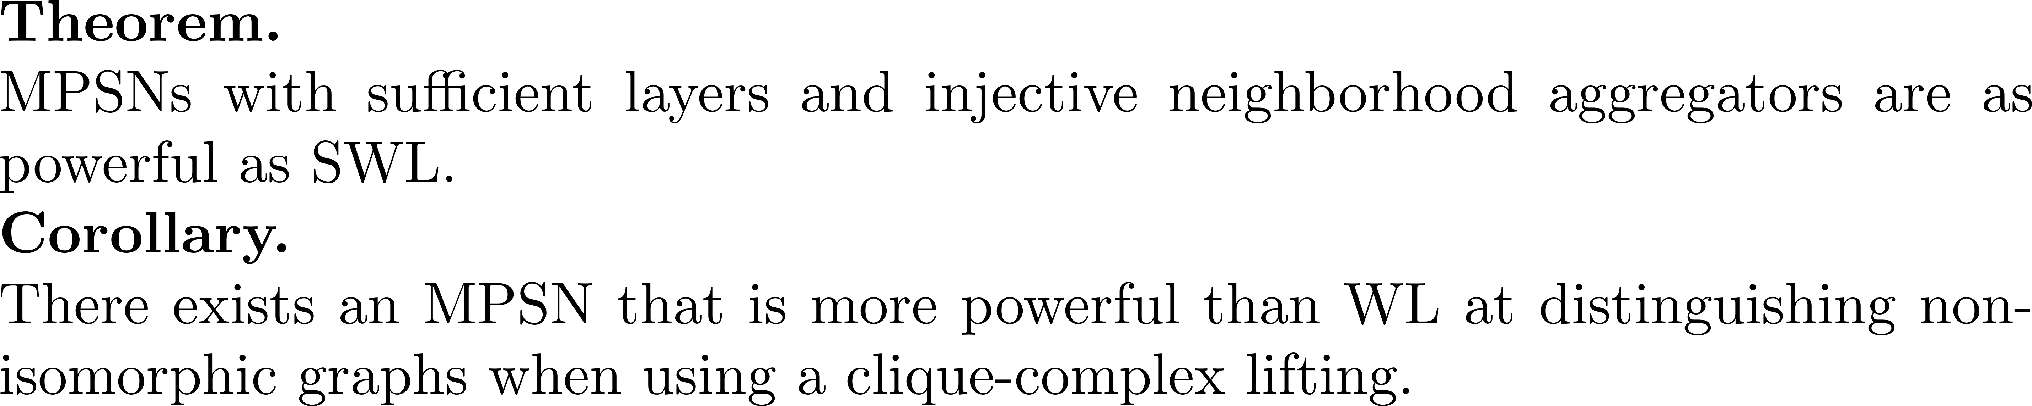
Message passing simplicial networks (MPSN)
Notes:
However, we can now interpret using a filled triangle that they have worked together. Such triangles are called 2-simplex.
Simplicial neural networks are SC based message-passing networks, which are more expressive than graph neural networks because they process high-order information. However, training SNNs requires task-specific labels, which can be expensive and difficult to retrieve when dealing with multiple labeling schemes and sensitive information.

Slide 13
Results
Graph classification
Notes:
However, we can now interpret using a filled triangle that they have worked together. Such triangles are called 2-simplex.
Simplicial neural networks are SC based message-passing networks, which are more expressive than graph neural networks because they process high-order information. However, training SNNs requires task-specific labels, which can be expensive and difficult to retrieve when dealing with multiple labeling schemes and sensitive information.

Slide 14
Results
Node classification
Notes:
However, we can now interpret using a filled triangle that they have worked together. Such triangles are called 2-simplex.
Simplicial neural networks are SC based message-passing networks, which are more expressive than graph neural networks because they process high-order information. However, training SNNs requires task-specific labels, which can be expensive and difficult to retrieve when dealing with multiple labeling schemes and sensitive information.

Slide 15
Results
Simplex prediction
Notes:
However, we can now interpret using a filled triangle that they have worked together. Such triangles are called 2-simplex.
Simplicial neural networks are SC based message-passing networks, which are more expressive than graph neural networks because they process high-order information. However, training SNNs requires task-specific labels, which can be expensive and difficult to retrieve when dealing with multiple labeling schemes and sensitive information.

Slide 16

Unsupervised Parameter-free Simplicial Representation Learning with Scattering Transforms
Hiren Madhu, Sravanthi Gurugubelli, and Sundeep Prabhakar Chepuri
Dept. of Electrical Communication Engineering
Indian Institute of Science, Bangalore

Slide 17
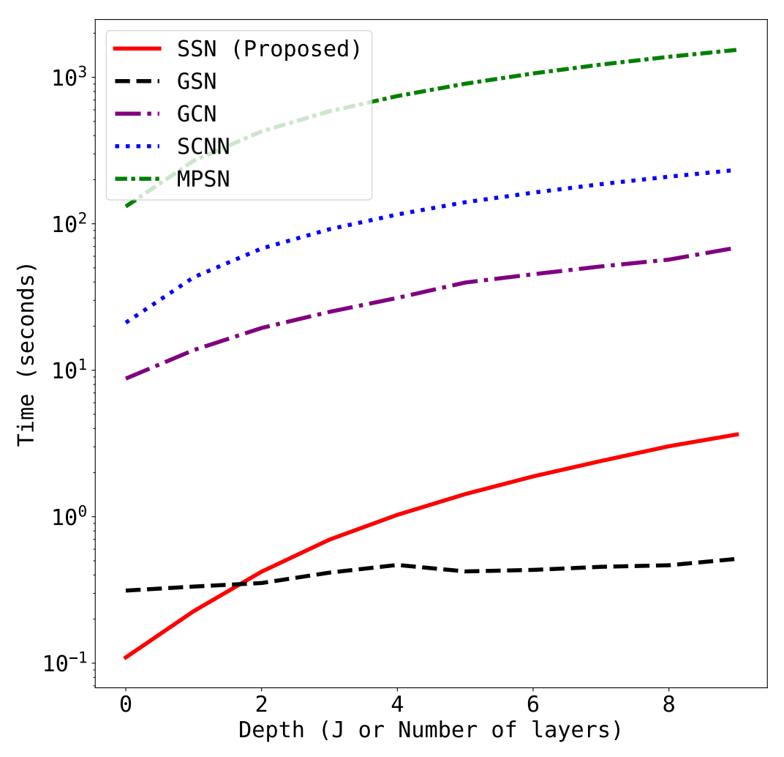


MPSN - Limitations
High parameter complexity
Aggregation from different types of neighborhoods and different orders of simplices increases trainable parameters
More parameters lead to a large training time
Dependency on large training data
SNNs need substantial training data for optimal performance
Obtaining task-specific labels can be challenging

Slide 18
Simplicial Scattering Network (SSN)
We propose a simplicial scattering network (SSN), a parameter-free model that
Extracts task-agnostic features from simplicial complex data, eliminating the need for labels
Utilizes a deep filter bank, which captures high-frequency information across multiple scales
Exhibits permutation equivariance, non-expansiveness, and robustness to structural perturbations

Slide 19
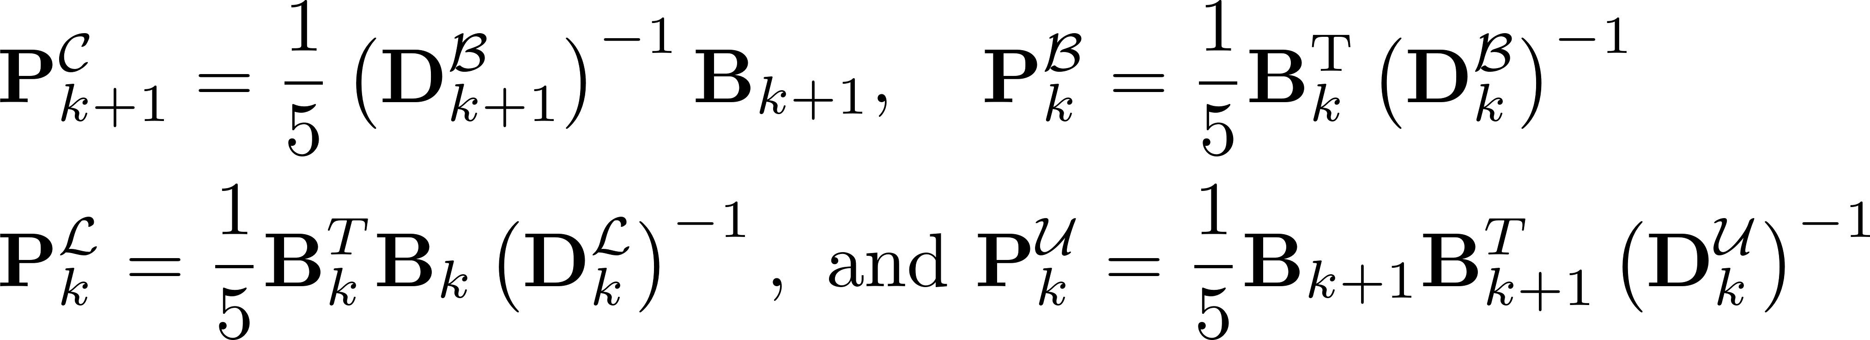
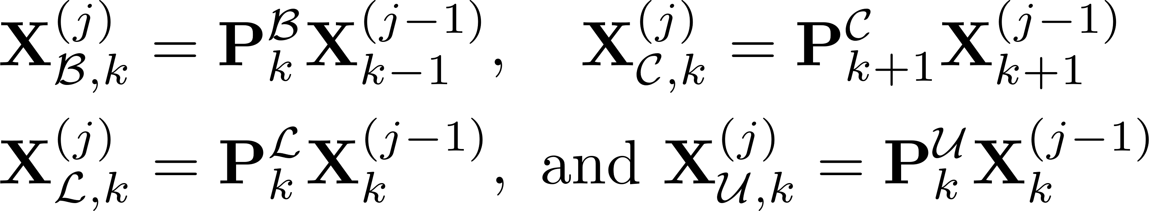
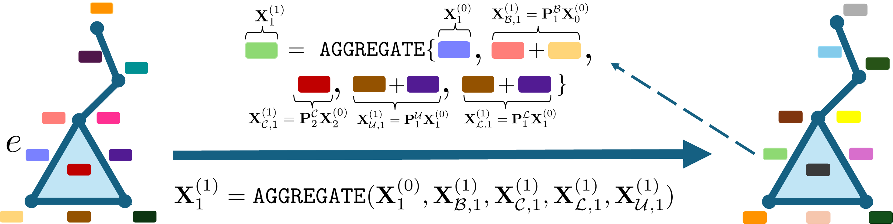
Simplicial Scattering Network (SSN)
Simplicial random walks
Random walk matrices - denote transition probabilities between adjacent simplices
Information propagation - information from neighborhoods is averaged - acts as low-pass filtering - leads to information loss
Aggregation of self-information with the information received from neighbors

Slide 20
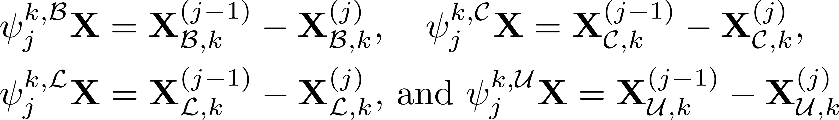
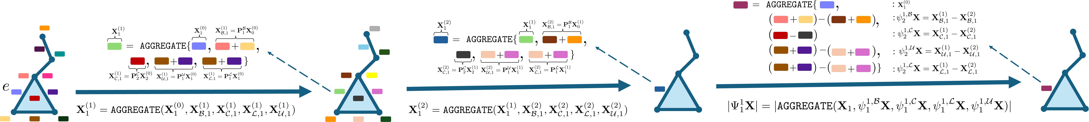
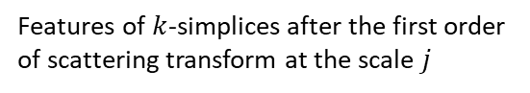
Simplicial Scattering Network (SSN)
Simplicial scattering transforms
Taking differences between aggregated features from consecutive scales - preserves high frequency information among different neighbors – mitigates oversmoothing
Features of $k$-simplices after the first order of scattering transform at the scale $j$
Set of embeddings of all orders

Slide 21
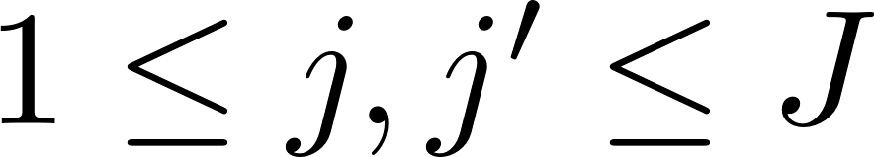
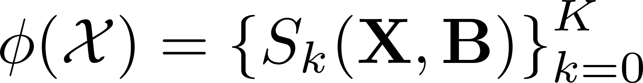
Simplicial Scattering Network (SSN)
Deep simplicial scattering network
Embeddings of k-simplices pooled from different layers
Does not contain any learnable parameters
Does not need training labels
Computationally efficient
Set of embeddings of simplices of different orders
Notes:
Repeat the simplicial scattering transform computations multiple times, with the output of one layer serving as the input to the next

Slide 22
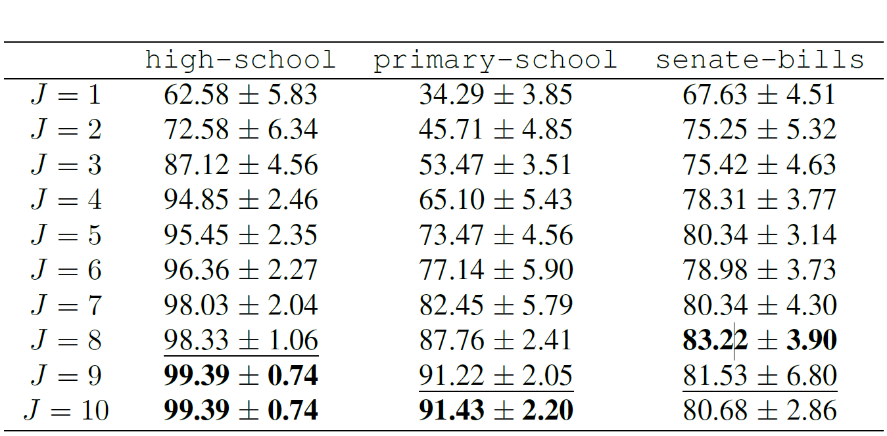
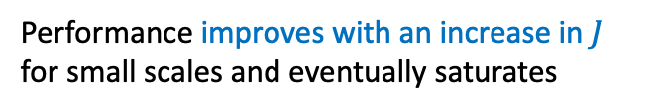
Simplicial Scattering Network (SSN)
Deep simplicial scattering network
Embeddings of k-simplices pooled from different layers
Performance improves with an increase in $J$ for small scales and eventually saturates
Notes:
Repeat the simplicial scattering transform computations multiple times, with the output of one layer serving as the input to the next

Slide 23
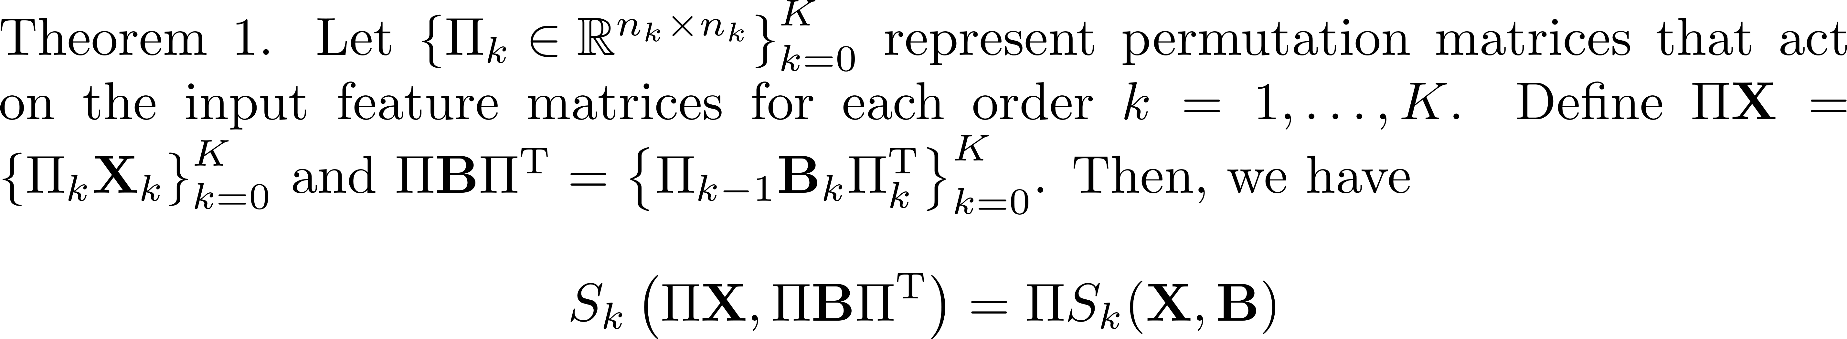
Theoretical Characterization
Permutation equivariance
Simplices in a permuted simplicial complex have
the same SSN representations as those in the original one

Slide 24
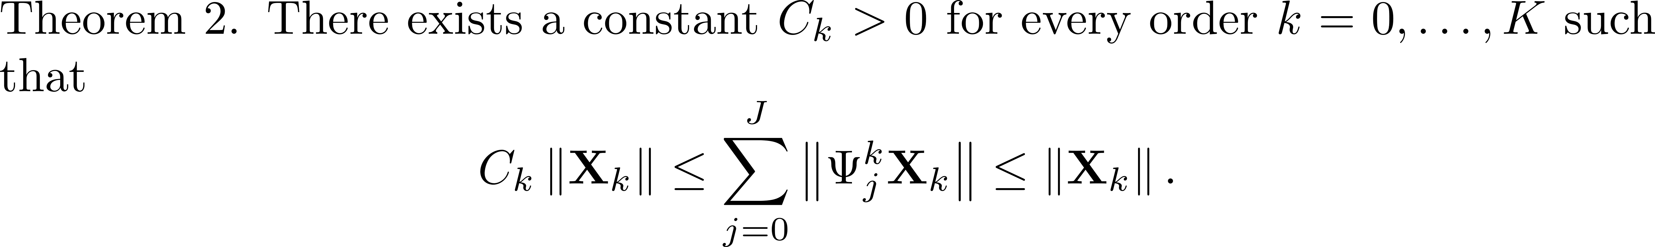
Theoretical Characterization
Non-expansiveness
Information in the signal is not entirely lost
- Transformed features retain at least as much expressiveness as the initial features
The signal is not amplified -
simplicial scattering transform is stable
Energy conservation before and after applying the scattering transform is guaranteed

Slide 25
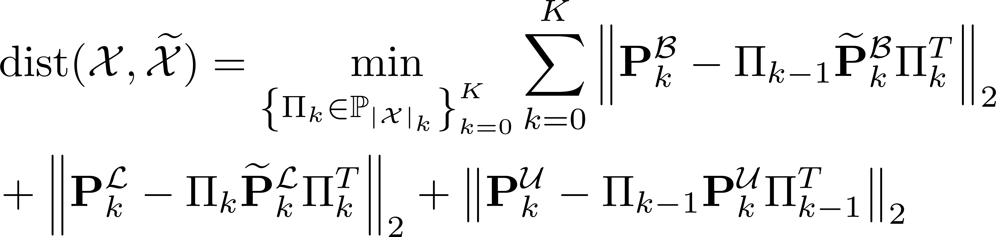
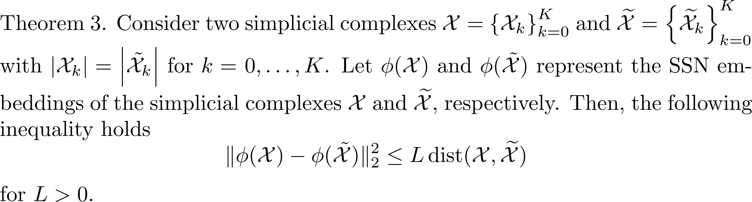
Theoretical Characterization
Stability
Similar input simplicial structures result in similar SSN representations
Similarity in structures is characterized using the simplicial diffusion distance

Slide 26
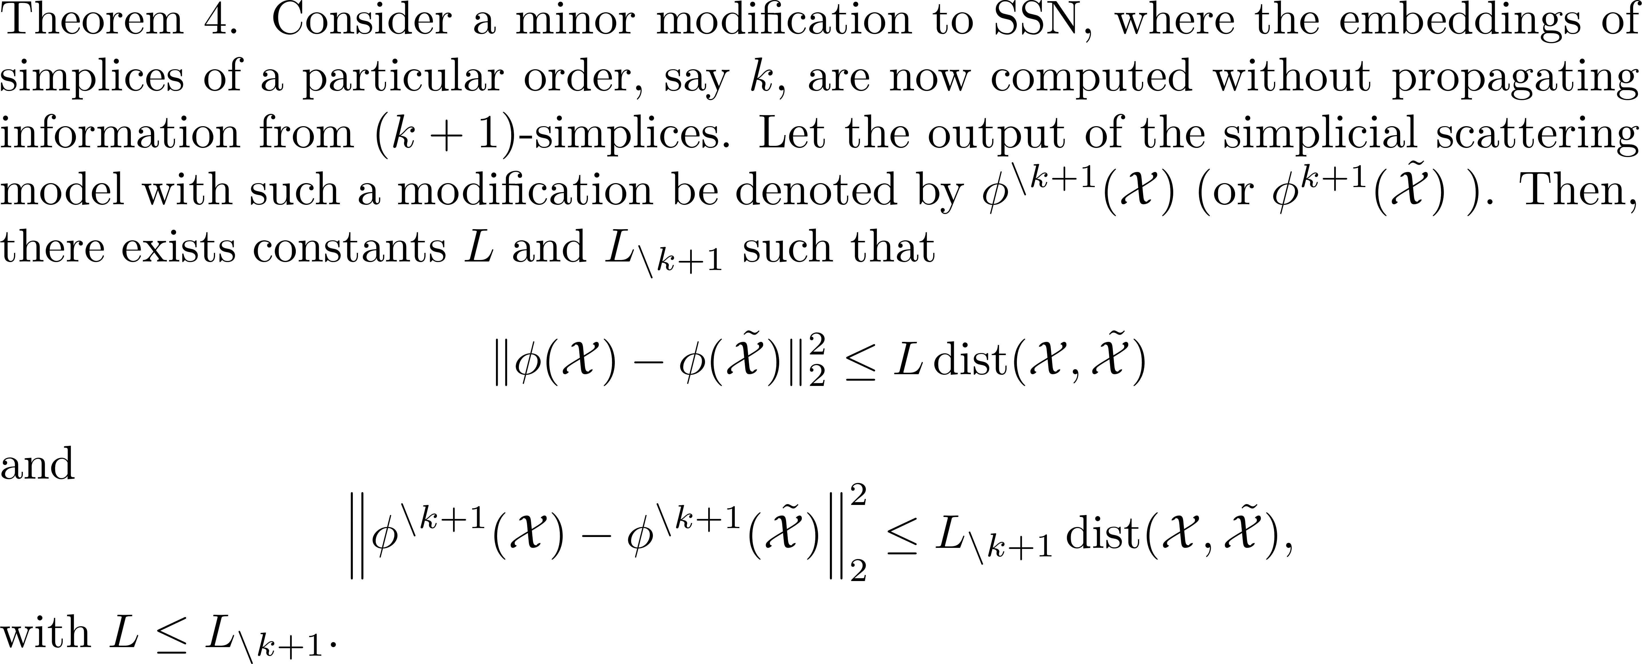
Theoretical Characterization
Impact of including higher-order simplices on the stability of SSN features
Utilizing information from higher-order simplices enhances the
stability of SSN representations

Slide 27
Results
Node classification
GNNs vs SNNs
GNNs, with fewer parameters, outperform SNNs
SNNs require more data for optimal learning due to their increased parameter complexity
Superior performance of SSNs
SSN outperforms GNNs and SNNs as it does not require training and considers the simplicial structure

Slide 28
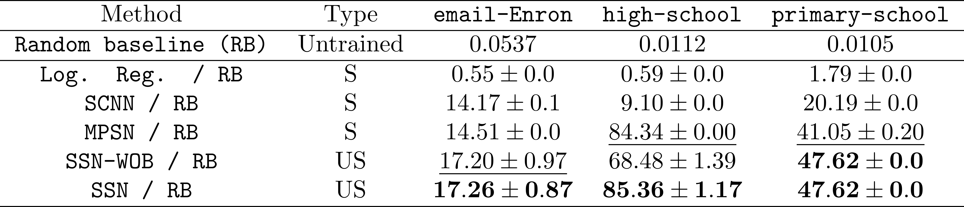
Numerical Experiments
Simplicial closure prediction
Representations for simplicial closure should embed both local information of the simplex of interest and
global information in the simplicial complex
Increasing the scale in SSN enhances the information aggregation range and provides a global view
SNNs cannot provide a global view due to oversmoothing and oversquashing

Slide 29
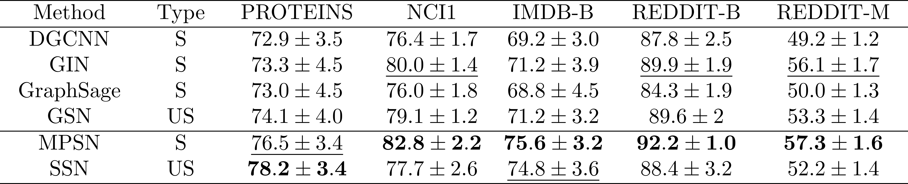
Numerical Experiments
Graph Classification
SNNs outperform GNNs and SSN
Availability of sufficient training data: MPSN learns an optimal set of parameters in a supervised training setting

Slide 30
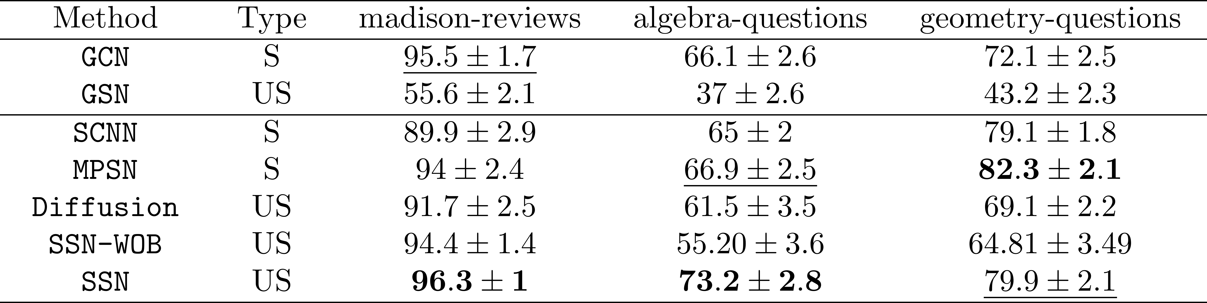
Numerical Experiments
Simplex prediction
Simplicial models, SNNs and SSN, perform well because substantial higher-order data is available

Slide 31
Conclusion
Summary
SSN vs GNNs:
SSN outperforms GNNs when
sufficient higher-order information is present
SSN vs SNNs:
SSN outperforms SNNs in tasks
where sufficient training data is unavailable
Limitations:
SSN
fails to perform when the dataset is large
is not scalable

Slide 32
Reading material
Message Passing Simplicial Networks
Topological Deep Learning: Going Beyond Graph Data
Simplicial Scattering

Slide 33
Thank you!
Notes:
Thank you.

